Slide 1
Welcome to Hello World Series
What is Version Control

Slide 2
Problem statement
I am a developer and interested in …
  Keeping every version of a file
  History
  Merging
  Comparisons between two versions

Slide 3
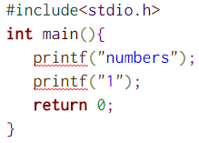
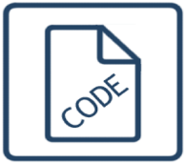
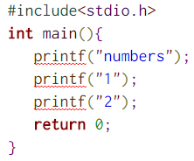
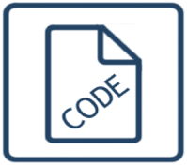
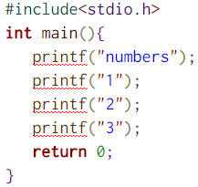

Being a developer…
Revision 1 – 1:00 PM
Revision 2 – 5:00 PM
Revision 3 – 7:00 PM
print_numbers.c
print_numbers.c
print_numbers.c

Slide 4

This story was simple – one file and one developer only
What if, you have many files and many developers

Slide 5
You definitely need some tool to help you!!!
Version control is a system that can track/control the changes your file(s) over time so that you or someone authorized person can recall specific versions later.
This so-called "Version Control System (VCS)" needs to be a software or a manual management of changes, which we will cover in next tutorials.
V
ersion
C
ontrol
S
ystem

Slide 6
Coming up Next
Manage versions yourself and it’s challenges
Notes:
In Slide Show mode, click the arrow to enter the PowerPoint Getting Started Center.

